Slide 1
Simple equation Solver
An offline tool to solve simple hand written problems

Slide 2
Introduction
A simple arithmetic equation solving program
Operators and numbers are recognized and are solved using the expression evaluation algorithm
The recognized equation is converted from infix to postfix expression
It is then solved using postfix expression evaluation algorithm
A small part our program involves Machine learning

Slide 3
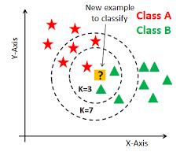
k-NN Algorithm

Slide 4
Pros
Robust to noisy training data
Effective if training data is large
Cons
The predicted value might not be same for different values of k
Computation cost is high since we have to calculate distance of k near elements
Not 100% accurate.

Slide 5
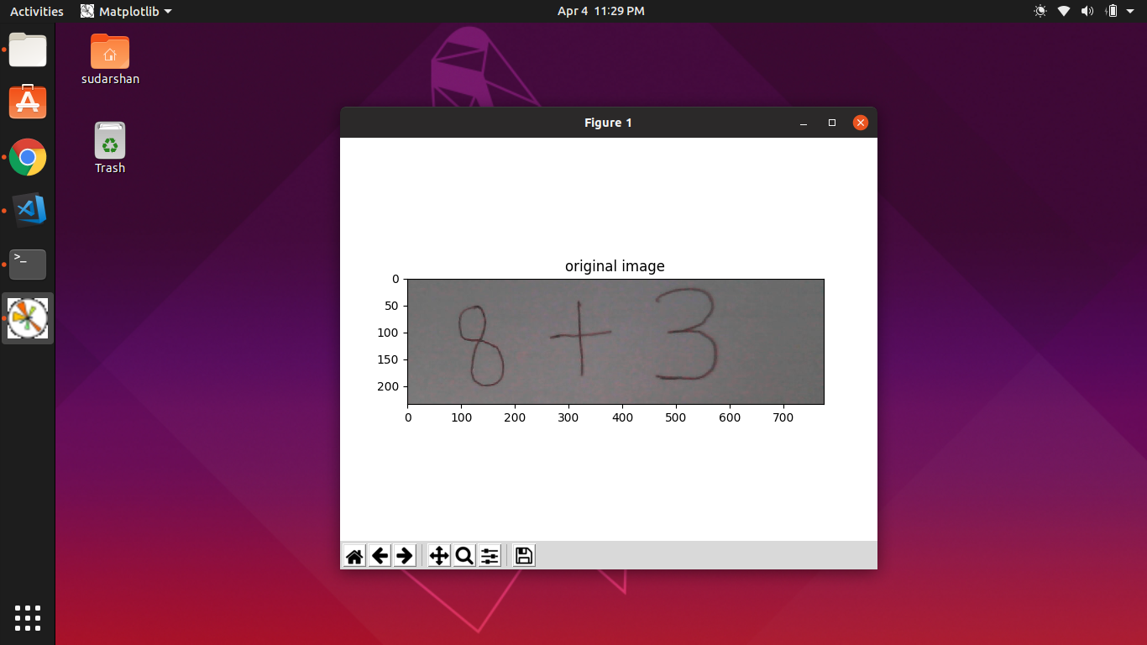
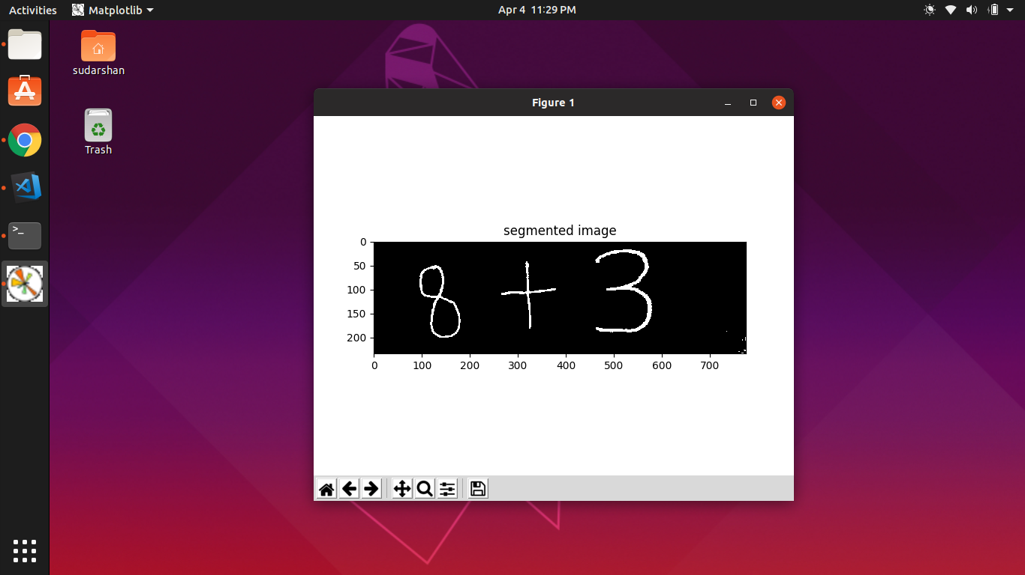
Result

Slide 6
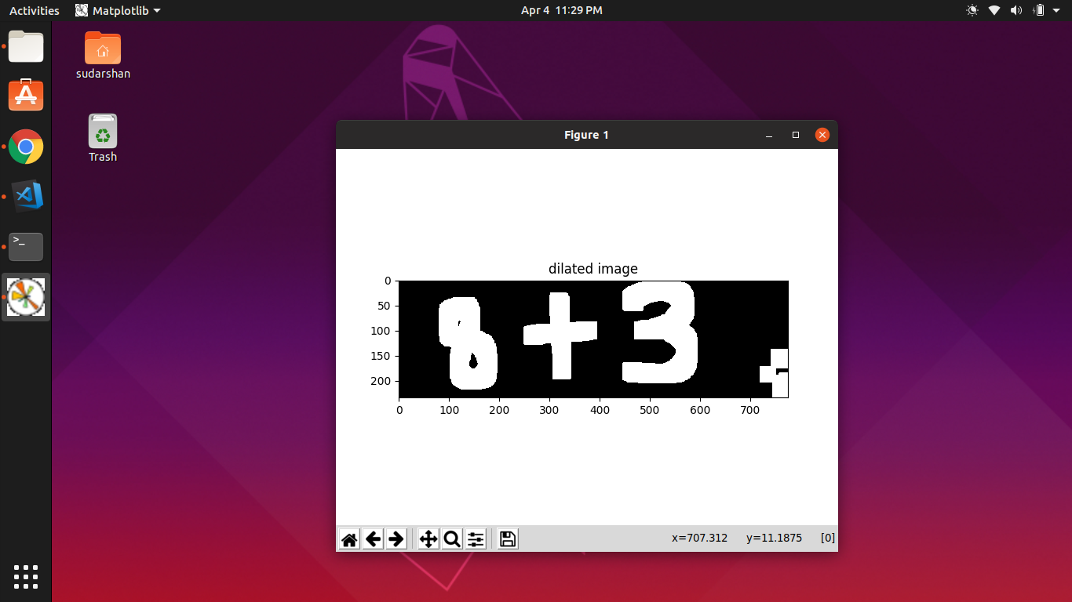
Result

Slide 7
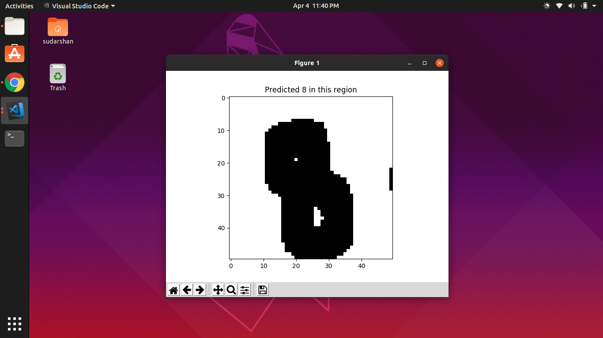
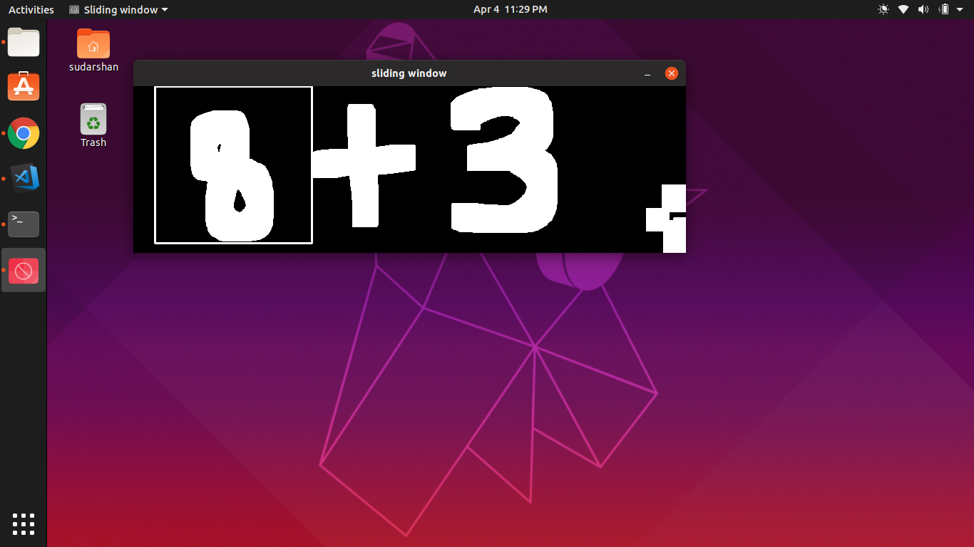
Result

Slide 8
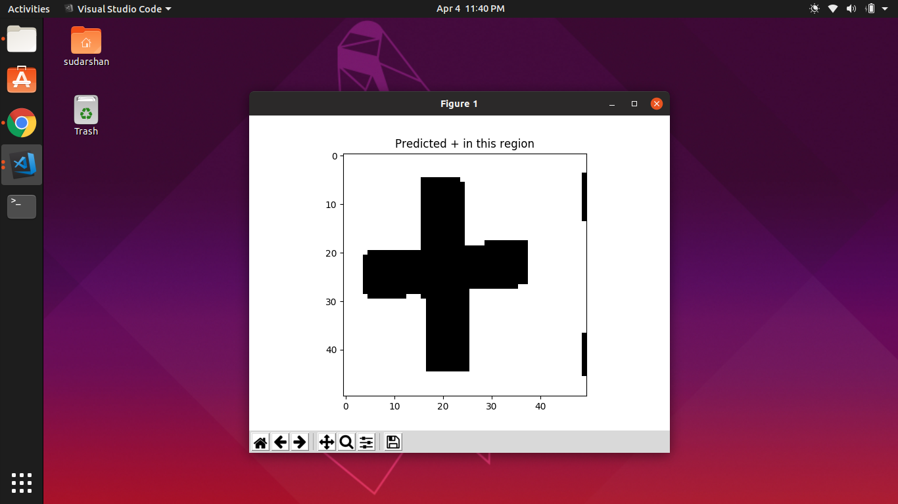
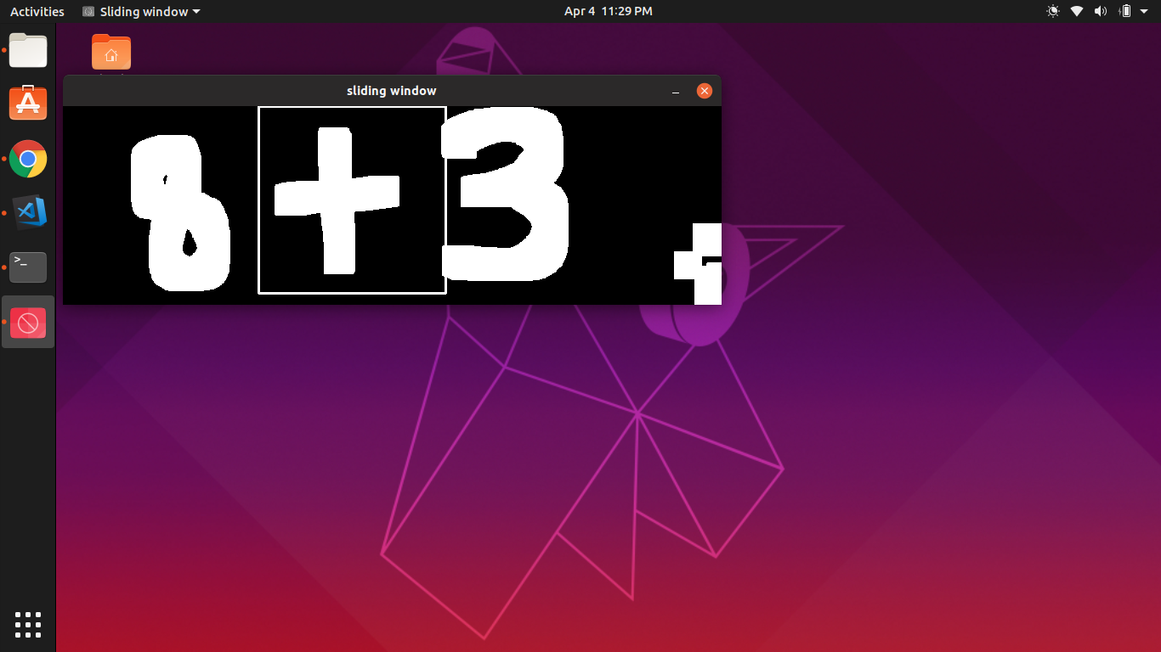
Result

Slide 9
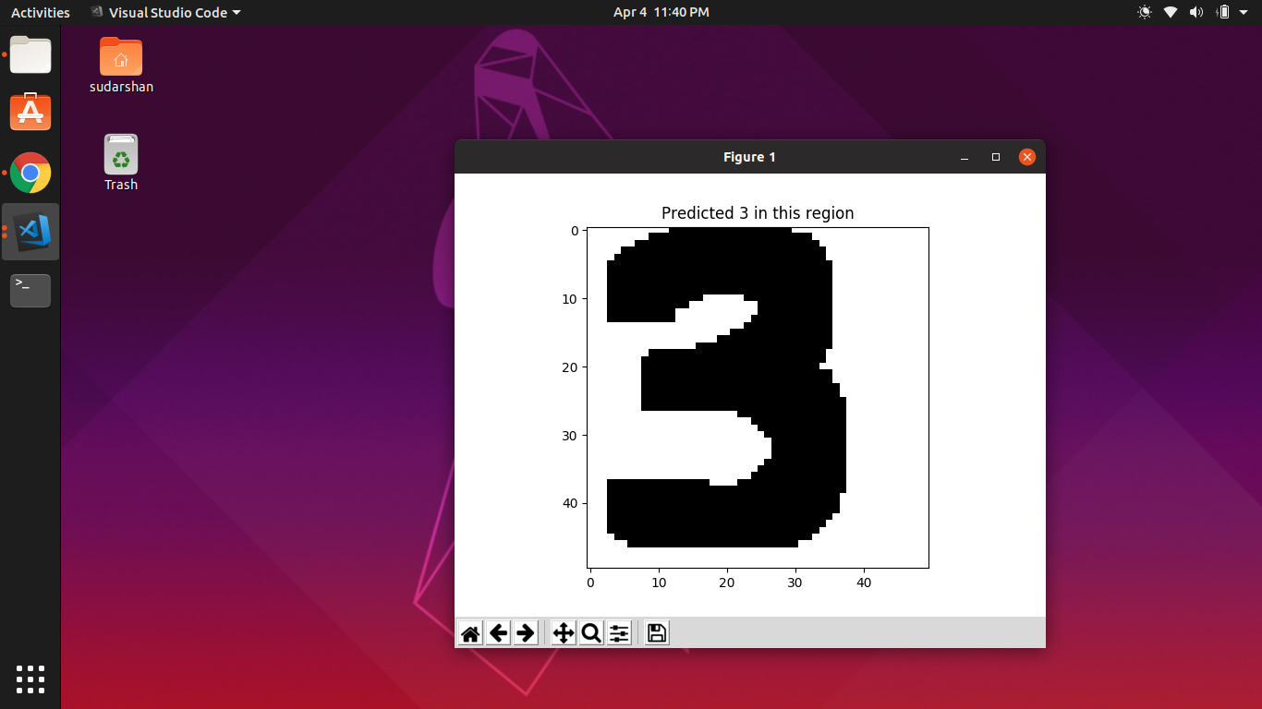
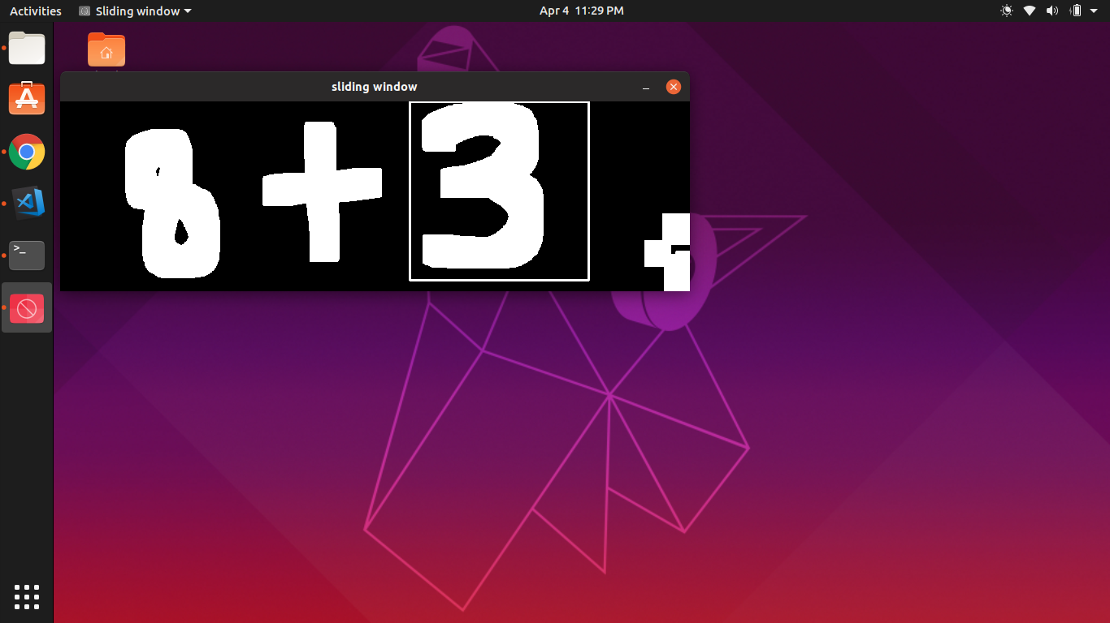
Result

Slide 10
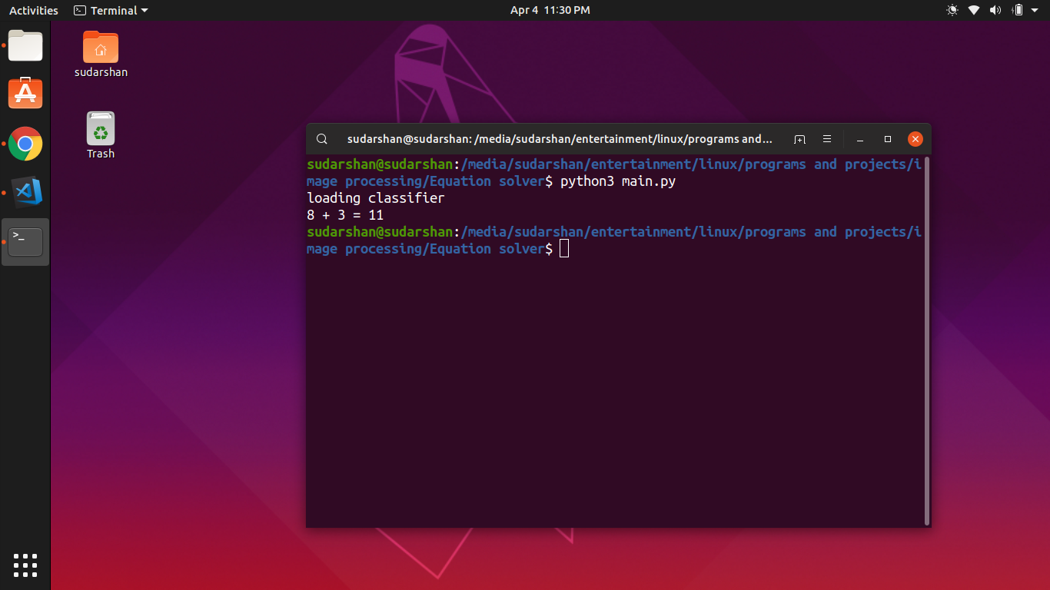
Result

Slide 11
Thank You

